Slide 1
BITS Pilani
Dr. Lavika Goel
Assistant Professor
Department of CSIS
Lecture 6: 23/2/2019
Pilani Campus

Slide 2
Topics
Text Classification
Introduction
Naïve Bayes Classification
Vector Space classification
2/22/2019 SS ZG537 (INFORMATION RETRIEVAL) 2

Slide 3
Text Classification-Supervised Learning
Given:
A description of an instance, d ∈ X
X is the instance language or instance space.
A fixed set of classes:
C = {c₁, c_{2,},…, c_{n} }
The classes are human-defined for the needs of an application (e.g., relevant vs. nonrelevant).
A training set D of labeled documents with each labeled document ⟨d,c⟩ ∈ X×C
Determine:
A learning method or algorithm which will enable us to learn a classifier γ:X→C
For a test document d, we assign it the class γ(d) ∈ C.
2/22/2019 SS ZG537 (INFORMATION RETRIEVAL) 3

Slide 4
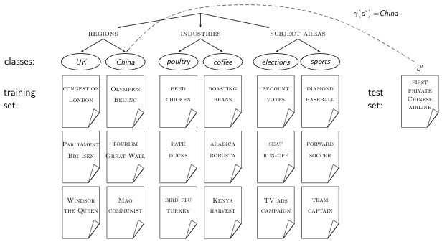
Document classification
2/22/2019 SS ZG537 (INFORMATION RETRIEVAL) 4
4

Slide 5
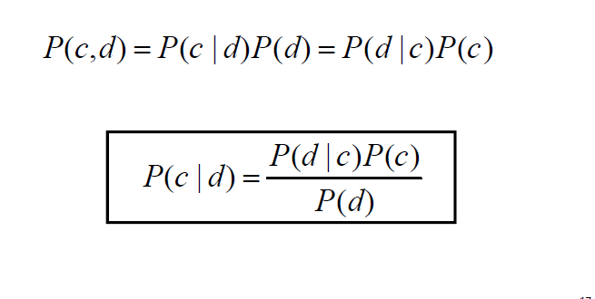
Bayes’ Rule for Text Classification
For a document d and a class c
2/22/2019 SS ZG537 (INFORMATION RETRIEVAL) 5

Slide 6

The Naive Bayes classifier
The Naive Bayes classifier is a probabilistic classifier.
We compute the probability of a document d being in a class c as follows:
n_{d} is the length of the document. (number of tokens)
P(t_{k}|c) is the conditional probability of term t_{k} occurring in document of class c
P(t_{k} |c) as a measure of how much evidence t_{k} contributes that c is the correct class.
P(c) is the prior probability of c.
If a document’s terms do not provide clear evidence for one class vs. another, we choose the c with highest P(c).
2/22/2019 SS ZG537 (INFORMATION RETRIEVAL) 6
6

Slide 7

Maximum a posteriori class
Our goal in Naive Bayes classification is to find the “best” class.
The best class is the most likely or maximum a posteriori (MAP) class cmap:
2/22/2019 SS ZG537 (INFORMATION RETRIEVAL) 7

Slide 8




Derivation of Naive Bayes rule
We want to find the class that is most likely given the document:
Apply Bayes rule
Drop denominator since P(d) is the same for all classes:
2/22/2019 SS ZG537 (INFORMATION RETRIEVAL) 8

Slide 9

Naive Bayes classifier
Classification rule:
Simple interpretation:
Each conditional parameter log is a weight that indicates how good an indicator t_{k} is for c.
The prior log is a weight that indicates the relative frequency of c.
The sum of log prior and term weights is then a measure of how much evidence there is for the document being in the class.
We select the class with the most evidence.
2/22/2019 SS ZG537 (INFORMATION RETRIEVAL) 9

Slide 10



Parameter estimation –
Maximum likelihood
Estimate parameters and from train data: How?
Prior:
N_{c} : number of docs in class c; N: total number of docs
Conditional probabilities:
T_{ct} is the number of tokens of t in training documents from class c (includes multiple occurrences)
We’ve made a Naive Bayes positional independence assumption here:
2/22/2019 SS ZG537 (INFORMATION RETRIEVAL) 10

Slide 11

Second independence assumption
For example, for a document in the class UK, the probability of generating QUEEN in the first position of the document is the same as generating it in the last position.
The two independence assumptions amount to the bag of words model.
2/22/2019 SS ZG537 (INFORMATION RETRIEVAL) 11

Slide 12
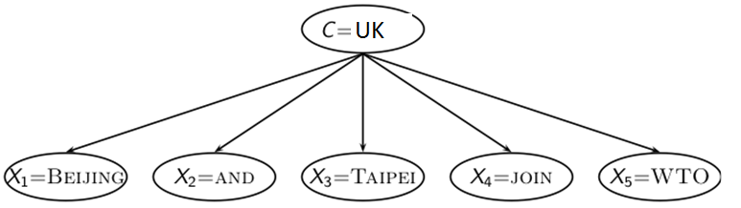

The problem with maximum likelihood estimates: Zeros
If WTO never occurs in class China in the train set:
2/22/2019 SS ZG537 (INFORMATION RETRIEVAL) 12

Slide 13

The problem with maximum likelihood estimates: Zeros
If there were no occurrences of WTO in documents in class China, we’d get a zero estimate:
We will get P(China|d) = 0 for any document that contains WTO!
Zero probabilities cannot be conditioned away.
2/22/2019 SS ZG537 (INFORMATION RETRIEVAL) 13

Slide 14


To avoid zeros: Add-one smoothing
Before:
Now: Add one to each count to avoid zeros:
B is the number of different words (in this case the size of the vocabulary:)
2/22/2019 SS ZG537 (INFORMATION RETRIEVAL) 14

Slide 15
Algorithm
Estimate parameters from the training corpus using add-one smoothing
For a new document, for each class, compute sum of (i) log of prior and (ii) logs of conditional probabilities of the terms
Assign the document to the class with the largest score
2/22/2019 SS ZG537 (INFORMATION RETRIEVAL) 15

Slide 16
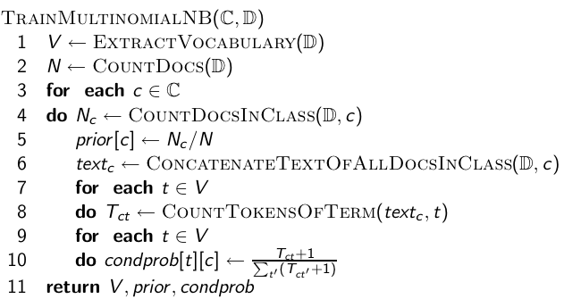
Naive Bayes: Training
2/22/2019 SS ZG537 (INFORMATION RETRIEVAL) 16

Slide 17
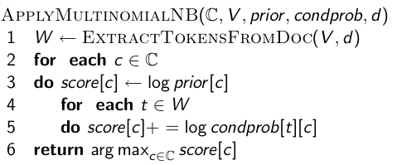
Naive Bayes: Testing
2/22/2019 SS ZG537 (INFORMATION RETRIEVAL) 17

Slide 18
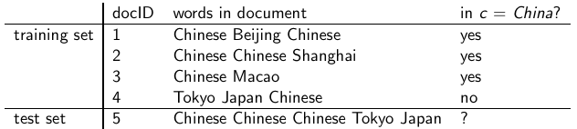
Example
Estimate parameters of Naive Bayes classifier
Classify test document
2/22/2019 SS ZG537 (INFORMATION RETRIEVAL) 18

Slide 19
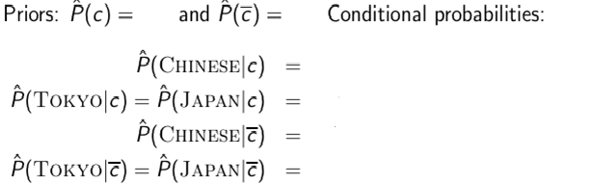
Example
2/22/2019 SS ZG537 (INFORMATION RETRIEVAL) 19

Slide 20
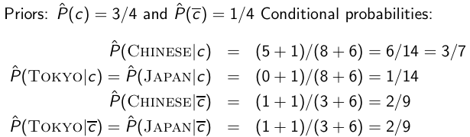
Example: Parameter estimates
The denominators are (8 + 6) and (3 + 6) because the lengths of text_{c} and text_{c’} are 8 and 3, respectively, and because the constant B is 6 as the vocabulary consists of six terms.
2/22/2019 SS ZG537 (INFORMATION RETRIEVAL) 20

Slide 21

Example: Classification
Thus, the classifier assigns the test document to c = China.
The reason for this classification decision is that the three occurrences of the positive indicator CHINESE in d₅ outweigh the occurrences of the two negative indicators JAPAN and TOKYO.
2/22/2019 SS ZG537 (INFORMATION RETRIEVAL) 21

Slide 22
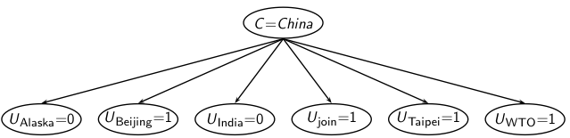
A different Naive Bayes model: Bernoulli model
The Bernoulli model estimates P(t|c) as the fraction of documents of class c that contain term t
The multinomial model estimates P (t|c) as the fraction of tokens or fraction of positions in documents of class c that contain term t
The Bernoulli model considers the binary occurrence information for the terms in the test document ignoring the number of occurences of the term.
The probability of non-occurrence of the terms of the vocabulary in the test document is also considered.
2/22/2019 SS ZG537 (INFORMATION RETRIEVAL) 22
22

Slide 23
Algorithm
2/22/2019 SS ZG537 (INFORMATION RETRIEVAL) 23

Slide 24
Example
2/22/2019 SS ZG537 (INFORMATION RETRIEVAL) 24

Slide 25
Example
Thus, the classifier assigns the test document to c = not China.
The model considers only the binary occurrence and not the term frequency.
2/22/2019 SS ZG537 (INFORMATION RETRIEVAL) 25

Slide 26
Vector Space Representation
Each document is a vector, one component for each term.
Terms are axes.
High dimensionality: 100,000s of dimensions
Normalize vectors (documents) to unit length
How can we do classification in this space?
2/22/2019 SS ZG537 (INFORMATION RETRIEVAL) 26

Slide 27
Classification Using Vector Spaces
Sec.14.1
As before, the training set is a set of documents, each labeled with its class (e.g., topic)
In vector space classification, this set corresponds to a labeled set of points (or, equivalently, vectors) in the vector space
Contiguity hypothesis. Documents in the same class form a contiguous region of space and Documents from different classes don’t overlap
2/22/2019 SS ZG537 (INFORMATION RETRIEVAL) 27

Slide 28
Classes in the Vector Space
Sec.14.1
China
Kenya
UK
2/22/2019 SS ZG537 (INFORMATION RETRIEVAL) 28

Slide 29
Sec.14.1
Classes in the Vector Space
Should the document ⋆ be assigned to China, UK or Kenya?
China
Kenya
UK
Find separators between the classes
2/22/2019 SS ZG537 (INFORMATION RETRIEVAL) 29

Slide 30
Sec.14.1
Classes in the Vector Space
China
Kenya
UK
How do we find separators that do a good job at classifying new documents like ⋆?
2/22/2019 SS ZG537 (INFORMATION RETRIEVAL) 30

Slide 31
Vector Space Classification Methods
Rocchio
divides the vector space into regions centered on centroids or prototypes, one for each class, computed as the centre of mass of all documents in the class.
simple and efficient, but inaccurate if classes are not approximately spheres with similar radii.
kNN (k Nearest Neighbour)
assigns the majority class of the k nearest neighbours to a test document.
requires no explicit training and can use the unprocessed training set directly in classification.
2/22/2019 SS ZG537 (INFORMATION RETRIEVAL) 31

Slide 32
Rocchio Classification
The best-known way of computing good class boundaries is Rocchio classification, which uses centroids to define the boundaries.
Use standard tf-idf weighted vectors to represent text documents
For training documents in each category, compute a prototype(centroid) vector by summing the vectors of the training documents in the category.
Assign each test document to the class of its closest centroid.
2/22/2019 SS ZG537 (INFORMATION RETRIEVAL) 32

Slide 33
Centroids
The notion of centroid applies to vectors and it is computed by associating to each vector a mass which is a positive number taking values between 0 and 1 and such that the sum of all the masses is equal to 1. The centroid of a set of vectors is also called the center of mass.
2/22/2019 SS ZG537 (INFORMATION RETRIEVAL) 33

Slide 34
Definition of centroid
Sec.14.2
where D_{c} is the set of all documents that belong to class c and v(d) is the vector space representation of d.
2/22/2019 SS ZG537 (INFORMATION RETRIEVAL) 34

Slide 35
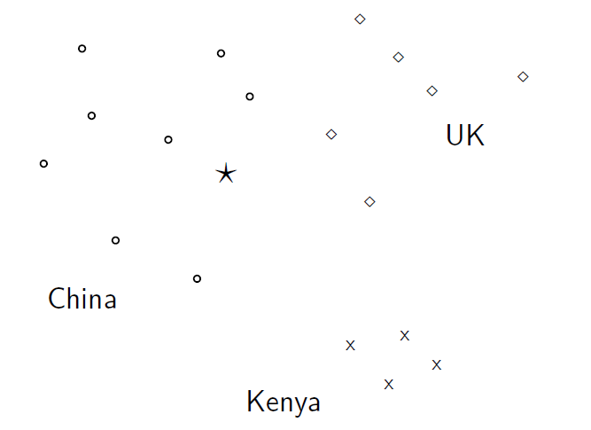
Illustration of Rocchio
2/22/2019 SS ZG537 (INFORMATION RETRIEVAL) 35

Slide 36
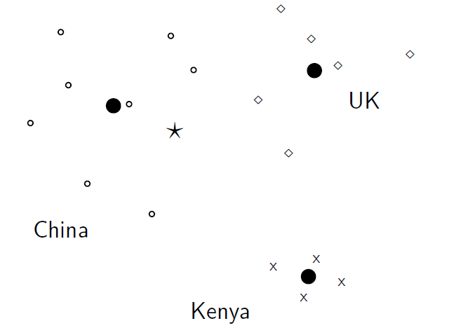
Illustration of Rocchio
2/22/2019 SS ZG537 (INFORMATION RETRIEVAL) 36

Slide 37
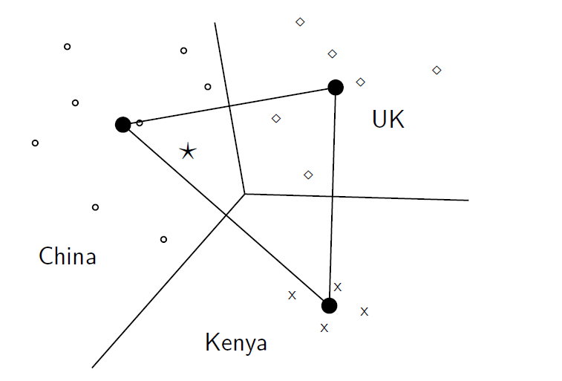
Illustration of Rocchio
2/22/2019 SS ZG537 (INFORMATION RETRIEVAL) 37

Slide 38
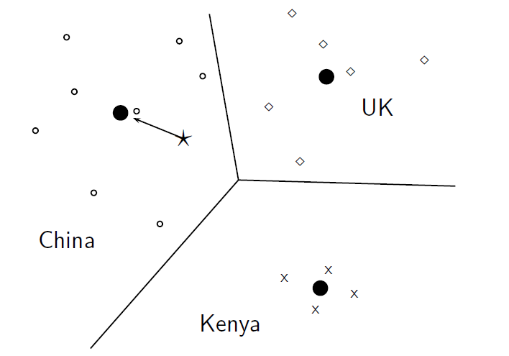
Illustration of Rocchio
2/22/2019 SS ZG537 (INFORMATION RETRIEVAL) 38

Slide 39
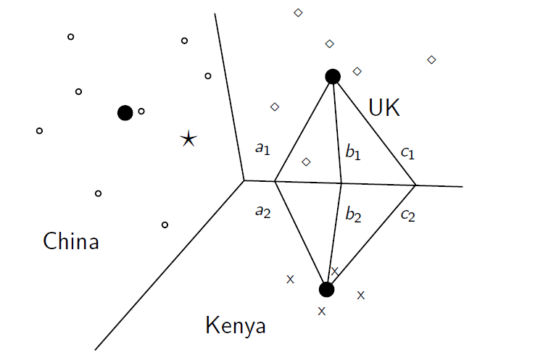
Illustration of Rocchio
2/22/2019 SS ZG537 (INFORMATION RETRIEVAL) 39

Slide 40
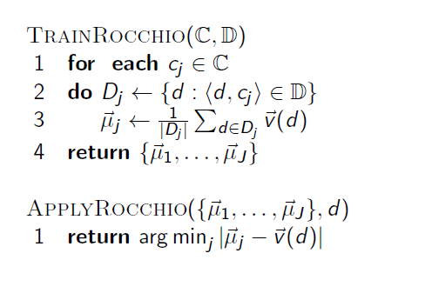
Rocchio algorithm
2/22/2019 SS ZG537 (INFORMATION RETRIEVAL) 40

Slide 41
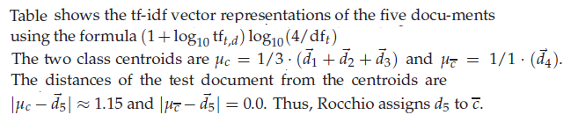
Example
2/22/2019 SS ZG537 (INFORMATION RETRIEVAL) 41

Slide 42
Rocchio classification
Sec.14.2
Rocchio forms a simple representation for each class: the centroid/prototype
Classification is based on similarity to / distance from the prototype/centroid
It does not guarantee that classifications are consistent with the given training data
It is little used outside text classification
It has been used quite effectively for text classification
But in general worse than Naïve Bayes
Again, cheap to train and test documents
2/22/2019 SS ZG537 (INFORMATION RETRIEVAL) 42

Slide 43
k Nearest Neighbour Classification
It is another vector space classification method.
It also is very simple and easy to implement.
It is more accurate (in most cases) than Naive Bayes and Rocchio.
2/22/2019 SS ZG537 (INFORMATION RETRIEVAL) 43

Slide 44
k Nearest Neighbour Classification
kNN = k nearest neighbours
kNN classification rule for k = 1 (1NN): Assign each test document to the class of its nearest neighbour in the training set.
kNN classification rule for k > 1 (kNN): Assign each test document to the majority class of its k nearest neighbours in the training set.
Rationale of kNN: contiguity hypothesis
We expect a test document d to have the same label as the training documents located in the local region surrounding d.
2/22/2019 SS ZG537 (INFORMATION RETRIEVAL) 44

Slide 45
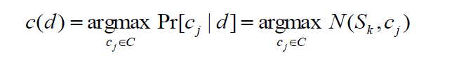
k Nearest Neighbour Classification
Given a test doc d and the training data
identify the set S_{k} of the k nearest neighbours of d, i.e., the k training docs most similar to d.
for each class c_{j} ∈ C
compute N(S_{k} , c_{j}) the number of S_{k} members that belong to class c_{j}
estimate Pr[c_{j} |d] as N(S_{k} , c_{j})/k
classify d to the majority class of S_{k} members.
2/22/2019 SS ZG537 (INFORMATION RETRIEVAL) 45

Slide 46
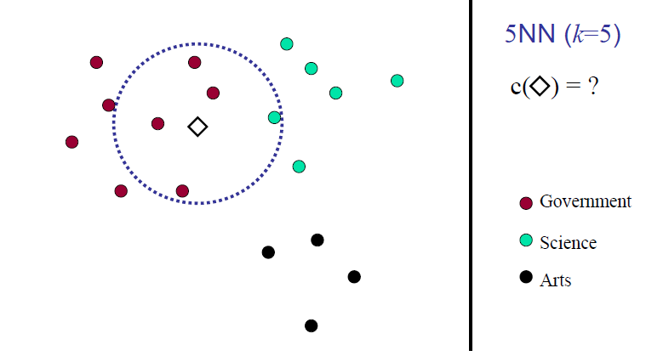
kNN Example
2/22/2019 SS ZG537 (INFORMATION RETRIEVAL) 46

Slide 47
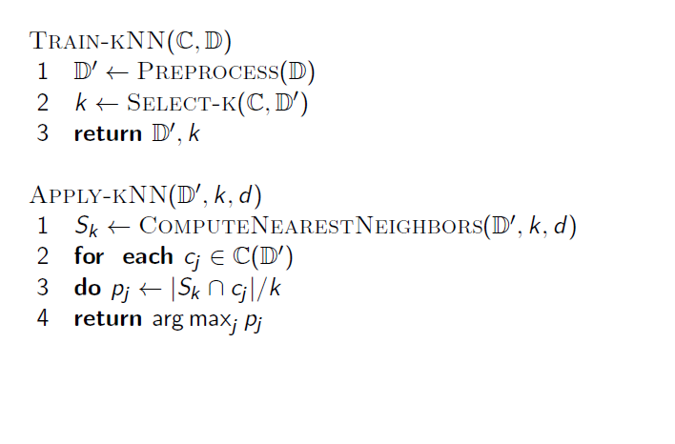
kNN Algorithm
2/22/2019 SS ZG537 (INFORMATION RETRIEVAL) 47

Slide 48
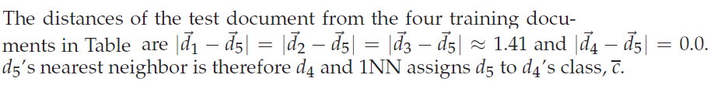
Example
2/22/2019 SS ZG537 (INFORMATION RETRIEVAL) 48

